Slide 1


Slide 2
Using AI in Fish Farming
By ESTHER GATHONI GIKAARA
Admission No: xxxxxx

Slide 3
Background information
Problems with the environment, failure, and disease outbreaks were problems with traditional fish farming.
AI integration facilitates feeding schedules, foresees/prevents problems, and allows for real-time monitoring of fish health and water quality.
Benefits include reduced environmental effect, enhanced feed efficiency, bigger disease control, and sustainable growth in industry.
To sum everything up, AI transforms fish farming by solving issues and ensuring sustainability.

Slide 4
Problem Statement
Problem Statement:
Due to high prices and little awareness, AI use in Kenyan fish farming is limited.
Despite the potential benefits, adoption of AI is hampered by a lack of information.
Barriers include high implementation costs for training and equipment.
Weaknesses of Current System:
Limited Accessibility: High cost makes AI inaccessible to small-scale farmers.
Technical Expertise: Requires specialized skills not always available or affordable.
Data Collection Challenges: Gathering and managing data can be difficult.
Lack of Tailored Solutions: Off-the-shelf AI may not meet fish farming needs.
Dependence on External Support: Small farmers rely on costly external help.
Limited Scalability: Some AI solutions struggle to scale in diverse environments

Slide 5
Objectives
General Objective: Through AI integration, increase overall farming experience and operational efficiency in the fish farming industry.
Specific Objectives:
Automate Routine Tasks: Make use of AI systems to identify diseases, optimize feed, and monitor water quality.
Create Algorithms for AI: To find trends in fish behavior, water quality, and environmental factors, analyze data.
Put AI-driven solutions into practice: Provide individualized agricultural advice, such as feeding plans and environmental tactics.
Boost Information Security:Put in place strong safeguards for privacy and data security in AI applications.

Slide 6
Research Questions: AI Integration in Fish Farming
Improving Disease Detection and Prevention: In order to increase output and reduce losses in fish farming, how might AI approaches maximize disease detection and prevention?
Ethical Issues and dangers: In particular, what dangers and ethical issues are related to data privacy and responsible AI practices when using AI in fish farming?
Enhancing Operational Efficiency: What are the obstacles preventing small-scale farmers from using AI-driven automation to optimize resources and enhance operational efficiency in fish farming?
Environmental Monitoring and Sustainability: How can AI-powered systems be tuned for maximum effect in fish farming, and what are the possible advantages and disadvantages of integrating these systems?

Slide 7
Literature Review on AI in Fish Farming
Introduction:
AI is revolutionizing fish farming by providing individualized services and increased operational efficiency.
Pay attention to the developments, uses, advantages, and difficulties associated with implementing AI.
AI Advancements:
Decision-making is improved, competitiveness is increased, and actionable insights are extracted via analytics driven by AI.
Data security and privacy, as well as ethical usage and regulatory compliance, are taken into account.

Slide 8
State of the art case studies and weaknesses
AI Applications in Fish Farming:
Automated monitoring: Increases effectiveness and prompt action.
Early diagnosis and treatment lead to lower losses.
Feed optimization increases productivity and the use of resources.
With predictive analytics, farm managers may make well-informed decisions.
Personalized Suggestions: Specifically designed plans for each operation.
Research Gaps and Challenges:
Ensuring the accuracy and privacy of data related to aquaculture.
Lack of transparency: problems with interpretability and the complexity of AI models.
Accessibility and Reluctance: Data privacy and job displacement are two stakeholder issues.
Language Barriers: Issues with communication in contexts with different language backgrounds.

Slide 9
Proposed System for Addressing Challenges in AI-Integrated Fish Farming
Improved Data Security and Privacy:-Used sophisticated encryption and safe storage to prioritize data privacy. to execute zero-trust security models and carry out routine audits and compliance examinations.
Strong Cybersecurity Procedures: to include advanced threat detection and response systems. utilizing multi-factor authentication and biometric verification, performing regular penetration tests, and conducting security assessments.
Moral Aspects to Take into Account: to follow ethical rules unique to AI in fisheries. should give duty, justice, and openness a priority while making decisions.
Transparency: Creating AI models that can be explained shed light on decision-making. This will make it easier for parties to collaborate and communicate in order to establish transparency and confidence.

Slide 10
Methodology: Agile Approach for AI in Fish Farming
Software Process Model: Agile Methodology
Strengths of Agile Methodology:
Scalability: The capacity to effectively handle growing data volumes and changing industry requirements.
Flexibility: The ability to adjust to new developments, procedures, and market conditions.
Modularity: AI solutions can be updated, maintained, and improved more easily.
Robustness: Gives AI applications' security, stability, and dependability first priority.
Real-time monitoring: Facilitates anticipatory reactions to dynamic circumstances in order to maximize performance.
Weaknesses of Agile Methodology:
Early on, there is limited predictability and it might be difficult to determine timetables with accuracy.
Dependency on Teamwork: The Effect of Communication Gaps on Development.
Risk of project delays and complexity as a result of added features is known as scope creep.
Flexibility Difficulties: Some teams could find it difficult to swiftly adjust to needs that change.

Slide 11
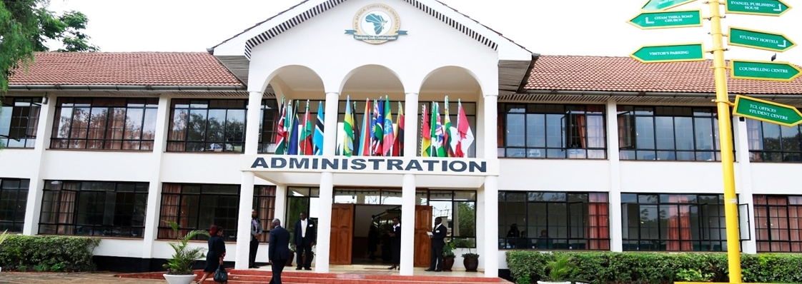
Contact Us PAN AFRICA CHRISTIAN UNIVERSITY
General enquiries: enquiry@pacuniversity.ac.ke
Admissions & applications: admissions@pacuniversity.ac.ke
Call us on: +254 73 440 0694 or +254 72 193 2050

